Slide 1
Class and objects

Slide 2
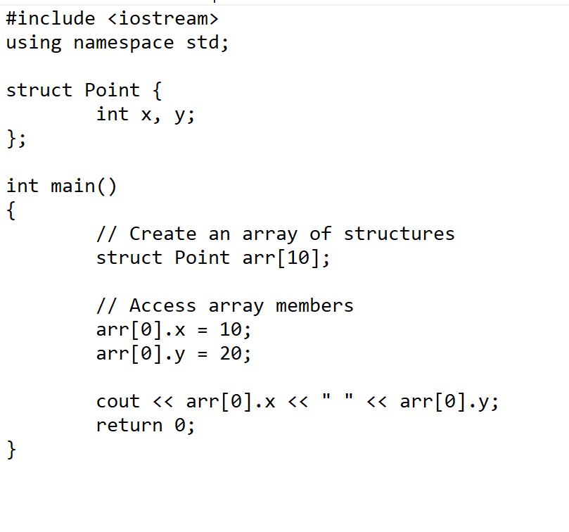
// A variable declaration with structure declaration.
struct Point
{
int x, y;
} p1; // The variable p1 is declared with 'Point'
// A variable declaration like basic data types
struct Point
{
int x, y;
};
int main()
{
struct Point p1; // The variable p1 is declared like a normal variable
}

Slide 3
Use one structure to represent two cars:
// Declare a structure named "car" struct car { string brand; string model; int year; }; int main() { // Create a car structure and store it in myCar1; car myCar1; myCar1.brand = "BMW"; myCar1.model = "X5"; myCar1.year = 1999; // Create another car structure and store it in myCar2; car myCar2; myCar2.brand = "Ford"; myCar2.model = "Mustang"; myCar2.year = 1969; // Print the structure members cout << myCar1.brand << " " << myCar1.model << " " << myCar1.year << "\n"; cout << myCar2.brand << " " << myCar2.model << " " << myCar2.year << "\n"; return 0; }

Slide 4
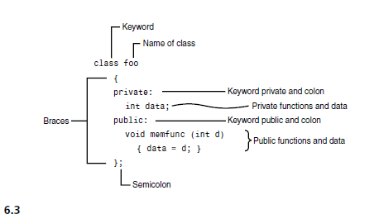
C++ is an object-oriented programming language.
Everything in C++ is associated with classes and objects, along with its attributes and methods
For example: in real life, a car is an object. The car has attributes, such as weight and color, and methods, such as drive and brake
Attributes and methods are basically variables and functions that belongs to the class. These are often referred to as "class members“
A class is a user-defined data type or a "blueprint" for creating objects

Slide 5
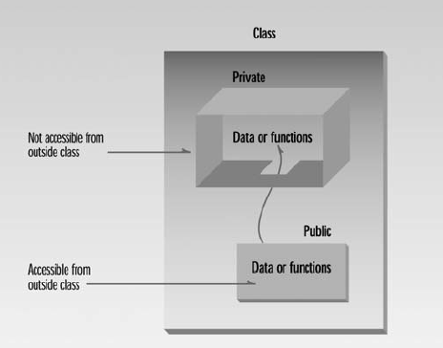
Member access specifiers
Classes can limit the access to their member functions and data
The three types of access specifiers
Public — Accessible wherever the program has access to an object of the class
private — Accessible only to member functions of the class
Protected — Similar to private and discussed later
A key feature of object-oriented programming is data hiding
The primary mechanism for hiding data is to put it in a class and make it private.
Private data or functions can only be accessed from within the class.
Public data or functions are accessible from outside the class.

Slide 6
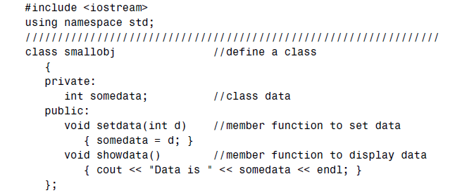
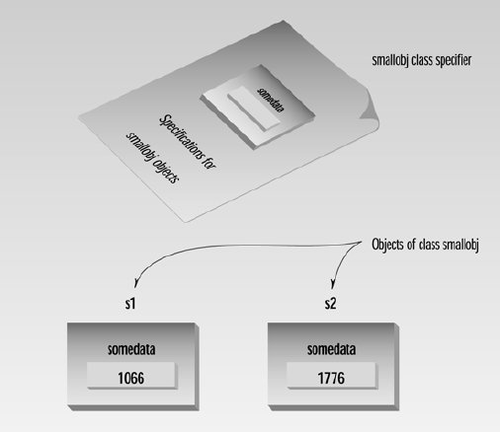
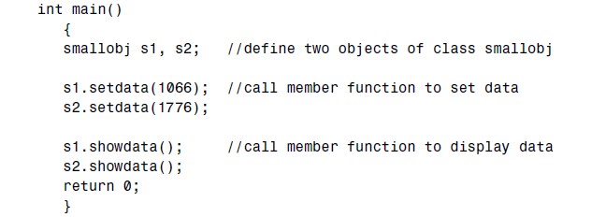

Slide 7
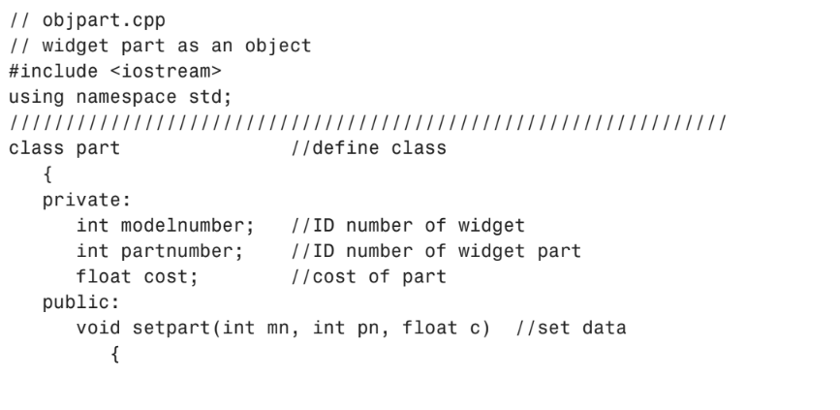
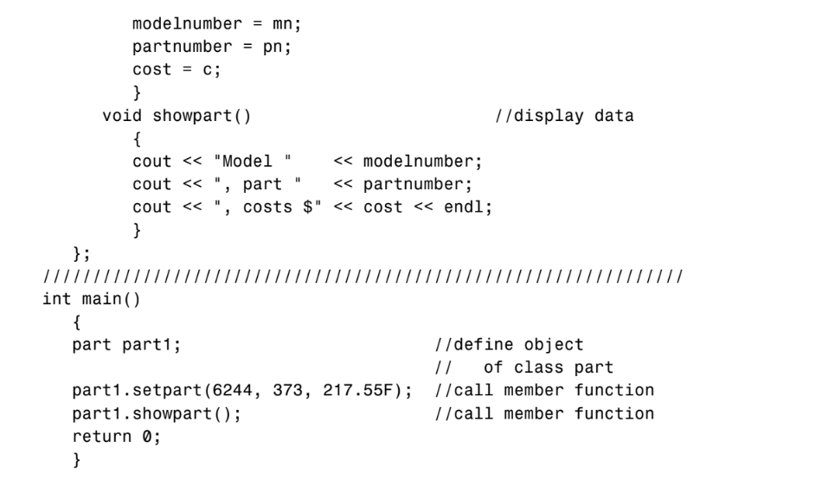
Here’s the output:
Model 6244, part 373, costs $217.55

Slide 8
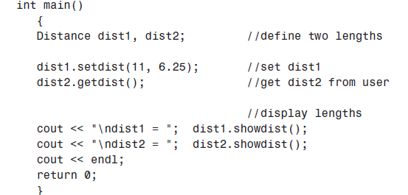
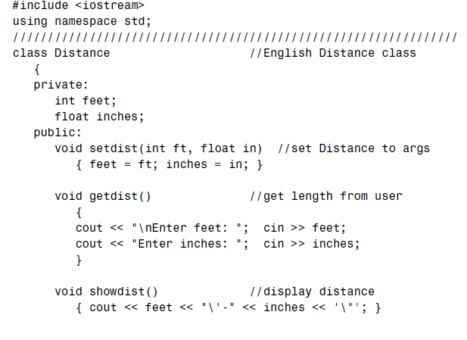
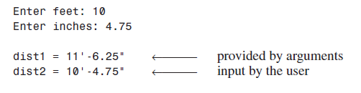
C++ Objects as Data Types
variables of a user-defined data type

Slide 9
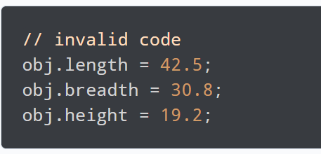
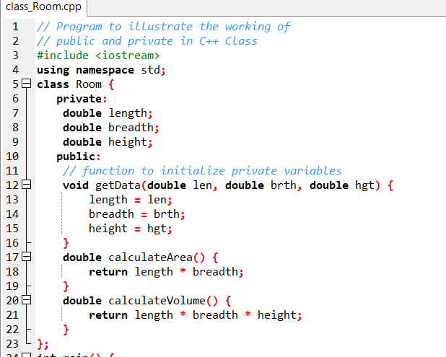
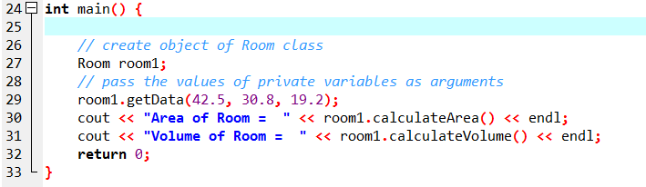
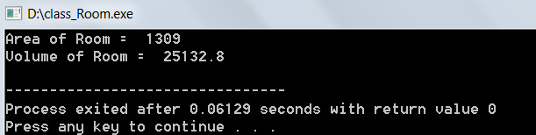

Slide 10
/* C++ program to create a simple class and object.*/
#include <iostream>
using namespace std;
class Hello
{
public:
void sayHello()
{
cout << "Hello World" << endl;
}
};
int main()
{
Hello h;
h.sayHello();
return 0;
}

